Slide 1

LetsMeet
Connecting real people in real life.

Slide 2



What is LetsMeet?
LetsMeet is an online network for professionals and enthusiasts to meet up in real life with groups that share common interests.
Discuss your favorite books together
Join a human-centered-design learning event
Sketch in the gallery at the museum

Slide 3



Where is LetsMeet?
We are located in New York, Chicago, and San Francisco.
New York
Chicago
San Francisco

Slide 4
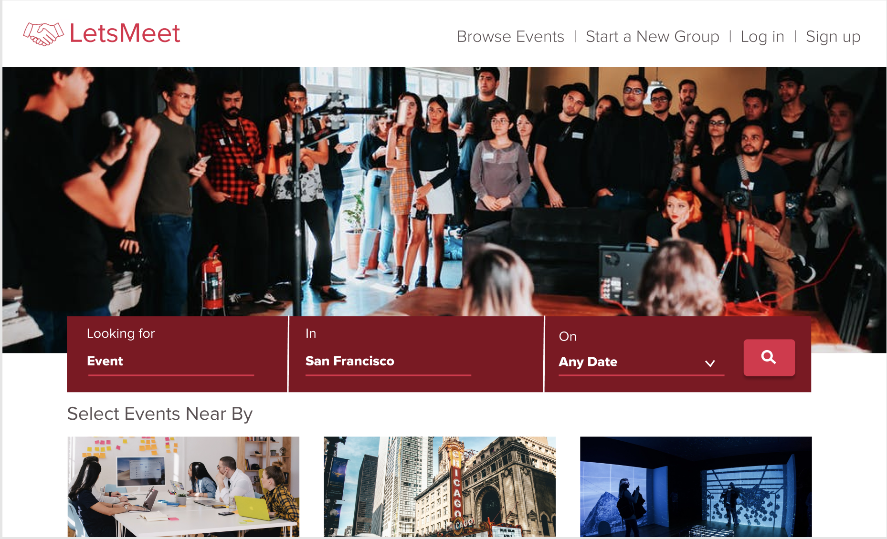
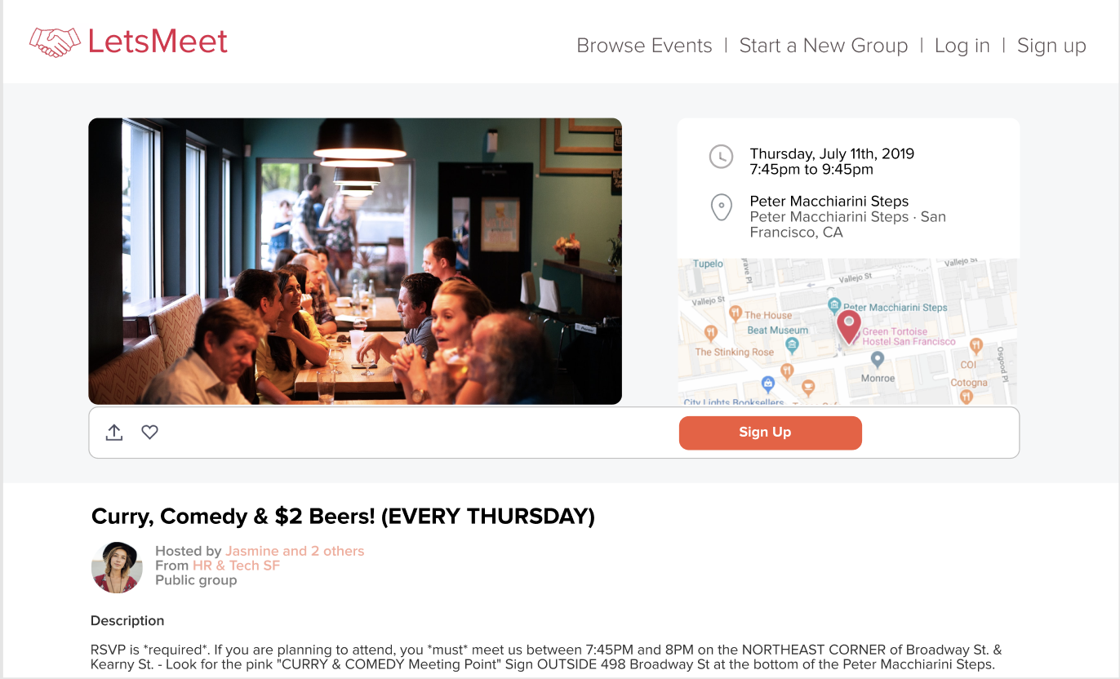
Why use LetsMeet?
People who use our website find new groups of friends in their city and make lasting connections.

Slide 5
Tech Team
You are the first data analyst on the tech team at LetsMeet. The tech team primarily consists of engineers, web designers, and app developers. LetsMeet hopes to include more data analysts and a data scientist as the company grows.
You will be managed by the VP of Engineering, Isabella. The following slides tell you a little about the people you will be working with.

Slide 6

Isabella
Position: VP of Engineering
Work Expertise: I have been in engineering for 8 years now, previously working with Apple, Google, and Amazon.
Fun Fact: I have published three books!
Hobbies: Scuba diving and dancing
Favorite Movie: Back to the Future
Myers-Briggs Type Indicator: ENFP

Slide 7

Quinn
Position: Engineer
Work Expertise: I taught myself how to code in high school, then used a bootcamp program to gain more engineering skills. This is my first full time position as an Engineer.
Fun Fact: I once swam with the dolphins in Hawaii.
Hobbies: Collecting sunglasses, tasting coffee in every state I visit.
Favorite Movie: Spirited Away
Myers-Briggs Type Indicator: INTJ

Slide 8

Cat
Position: Director of Sales
Work Expertise: After starting my own water color business, I worked in sales for the first time for my own company. After realizing how much I enjoyed it, I started pursuing sales positions at other companies. Before joining the LetsMeet team, I was the Director of Sales at REI.
Fun Fact: In my spare time, I teach watercolor painting classes.
Hobbies: Hiking, swimming, biking, boating, going to the beach.
Favorite Movie: The Wizard of Oz
Myers-Briggs Type Indicator: ESFP

Slide 9

Evelyn
Position: CEO
Fun Fact: I have run three marathons!
Work Expertise: After working as a business analyst with Lululemon, Apple, and LinkedIn, I have taken on the role of CEO at LetsMeet.
Hobbies: Meditation and running.
Favorite Movie: The Secret Life of Walter Mitty
Myers-Briggs Type Indicator: ESTP

Slide 10
The Data
Our data exists in a .sql file. Although we have looked at the data, you will be the first person to analyze the data.
The following slides provide an overview of our database, including details of each table.

Slide 11
1
grp
Groups that make up LetsMeet
grp_member
Group members that make up groups
venue_
Where groups meet
event
Events that groups put on
category
Different categories of groups
city
Information about cities that host groups
Tables in the Database
2
3
4
5
6

Slide 12
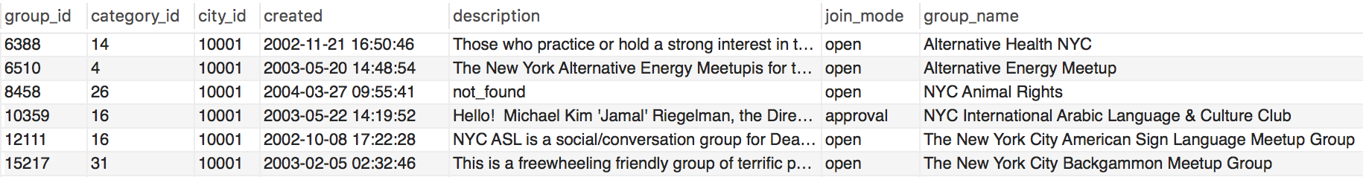
grp
The core part of LetsMeet are the groups. The grp table contains information about the groups that use LetsMeet to network. Our groups cover a huge range of topics such as animal rights, backgammon, kayaking, and dachshund.
Columns: group_id, category_id, city_id, created, description, join_mode, group_name, rating, visibility, members, who.
Notes - There are more groups than we can keep track of. That’s why we need you!

Slide 13
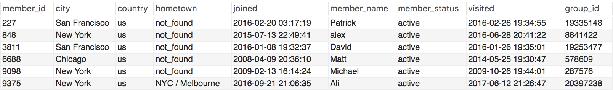
grp_member
The grp_member table contains data on individual members. Each row lists one member and one group. So members in multiple groups appear multiple times. Most members are based in the New York, Chicago, and San Francisco areas, but they come from all over the world.
Columns: member_id, city, country, hometown, joined, member_name, member_status, visited, group_id.
Notes - Members do not belong to LetsMeet. Members belong to groups. Technically groups do not belong to LetsMeet either. Membership comes from LetsMeet networking.

Slide 14
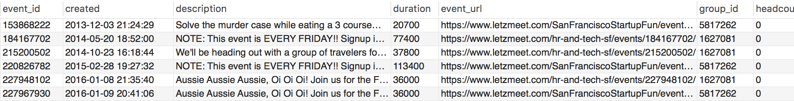
event
Events are what the members gather for. This table contains the most columns. Included are text descriptions, waitlist information, rsvp information, urls, and more.
Columns: event_id, created, description, duration, event_url, group_id, headcount, how_to_find_us, maybe_rsvp_count, event_name, photo_url, rsvp_limit, event_status, event time, updated, utc_offset, venue_id, visibility, waitlist_count, why, yes_rsvp_count.
Notes - Some of these columns may be extraneous.

Slide 15
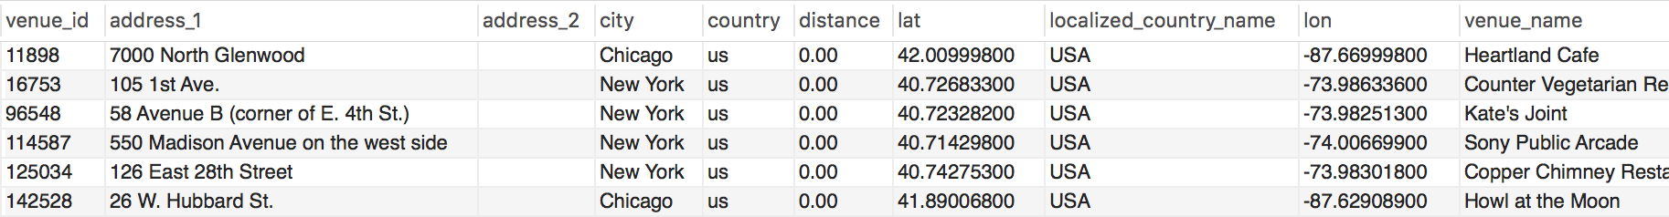
venue_
This table contains data on the venues that host LetsMeet events. Standard information like latitude and longitude along with the address are provided.
Columns: venue_id, address_1, address_2, city, country, distance, lat, localized_country_name, lon, venue_name, phone, state, zip, RAND() DOUBLE.
Notes - We often get requests about venues from group organizers.

Slide 16
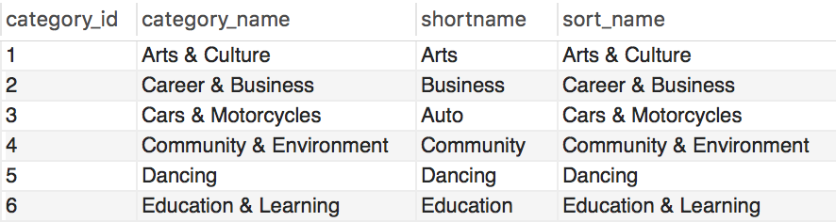
category
We organize our groups into the following categories: Arts & Culture, Career & Business, Cars & Motorcycles, Community & Environment, Dancing, Hobbies & Crafts, Language & Ethnic Identity, Lifestyle, Book Clubs, Movies & Film, Music, New Age & Spirituality, Outdoor & Adventure, Paranormal, Parents & Family, Pets & Animals, Photography, Religion & Beliefs, Sci-Fi & Fantasy, Singles, Socializing, Sports and Recreation, Support, Tech, Writing.
Columns: category_id, category_name, shortname, sort_name.
This table is the shortest and easiest to make sense of.

Slide 17
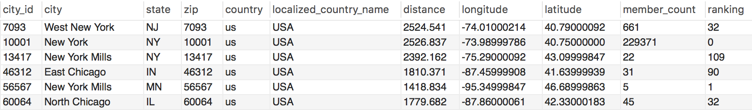
city
This table contains information about the cities where LetsMeet groups and members gather. In addition to state, zip, country, and latitude/longitude, a column member_count displays the number of members per city.
Columns: city_id, city, state, zip, country, localized_country_name, distance, longitude, latitude, member_count, ranking.
Notes - The city table could use a little cleaning.

Slide 18
Your Role
We’re excited to finally have someone who can analyze the data to gain new insights and drive business decisions. Since we are growing rapidly, this role will become increasingly important. Your role will include the following:
Respond to sales requests
Respond to engineering requests
Respond to Evelyn (CEO) requests
Analyze data for insights
Improve database structure
Write reports to summarize data
All requests will come from questions that we need a data analyst to answer!

Slide 19

Welcome to the team!

